Slide 1
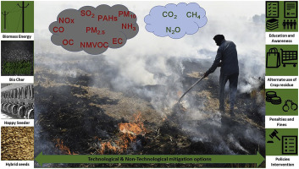

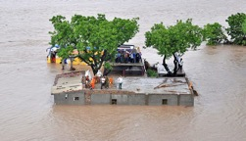
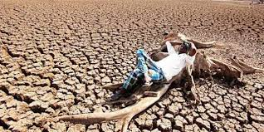
Climate Change Scenario in Asia Pacific
Highest Urbanization in APR
GDP per capita Loss: Asia (11%), Pacific (9.6%), South Asia (15.5%)
Sea level rise, 180 million vulnerable in APR
Residue Burning
Droughts and heat Waves
Frequent forest fires
14 Global Biodiversity hotspots in ASR out of 34
Floods

Slide 2
Climate change and Agriculture in AP Region
Food security of 3.5 billion people in APR
By 2050, climate change will toll on average >20% crop yields in APR region
Frequent heat wave and droughts
Urban air pollution in APR: 500K premature deaths every year, accounting 65% of global deaths
Average calorie availability will reduce by 15%
Average cereal consumption expected to decline by 24% in Asia compared to no climate change scenario
Additional 11 million Children will remain malnourished due to climate change in APR region
Counteract to climate change on nutrition in South Asia requires additional annual investments of 1.5 billion USD in rural development, and East Asia and the Pacific require almost 1 million USD more

Slide 3
Resilience to Climate Change
- Needs a Twin Pillar Strategy
Promote clean energy: Renewable and Green Energy – Solar, Electric, CNG
Minimize fossil fuel use: Biofuels from Sugarcane, Maize, Cereal Crop Residues etc
Promote carbon sequestration: Climate Smart Agriculture, Agro-forestry, Sivi-pastoral systems, Conservation Agriculture, Incentivizing Environmental Services
Knowledge sharing and partnership: Regional For a: APAARI, ASEAN, SAARC
Skill and capacity development: Youth and Women
Enabling Policy: Scaling innovations, Incentives for environmental services, Crop and livestock insurance
Genetic Resource Management
Natural Resource Management
http://www.taas.in

Slide 4
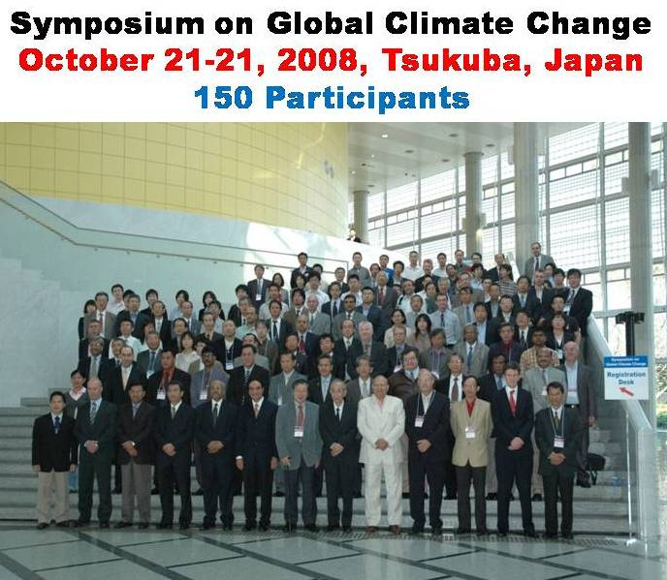
TSUKUBA DECLARATION
on
ADAPTING AGRICULTURE TO CLIMATE CHANGE
Strategy for Regional Resilience to Climate Change in Asia Pacific
Attainment of SDGs and climate change presents a major challenge
Agriculture continues to play a critical role for employment and livelihood security
Water is a key constraint : enhancing water use efficiency, micro-irrigation, watershed approach and water storage (ITKs)
Increasing food production locally is the best option to reduce poor people’s vulnerability to climate change variations
New genotypes tolerant to multiple stresses: drought, floods, heat, salinity, pests and diseases, will help in increasing food production
Reliable and timely early warning system using modern tools of information and space technologies is critical for monitoring cyclones, floods, drought and the movements of insects and pathogens.
Policies, institutions, partnership and skilled human resource are needed that assist in containing the risk and to provide protection against natural calamities
Governments of the region should collaborate on priorities to secure effective adaptation and mitigation strategies and their effective implementation through creation of a regional fund for improving climatic services and for effective implementation of weather-related risk management programs. Active participation of young professionals is therefore called for
Several possible approaches to enhance carbon sequestration in the APR soils: conservation agriculture, agroforestry, better fertilizer sources etc.
AP region will require substantial support in terms of institutional infrastructure, human resource capacity and the required political will
Advanced Research Institution, such as JIRCAS, could take the lead in establishing an ‘Advance Center for Agricultural Research and Information on Global Climate Change’ for serving the Asia-Pacific region

Slide 5
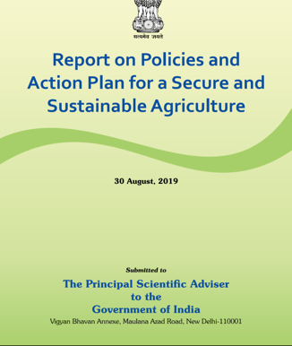
Enabling Policies to Harness Science for Resilience

